Slide 1
GETTING TO THE 2030 FINISH LINE:
Identifying and Filling Gender Data Gaps for Inclusive Development
Notes:
“Welcome and thank you all for joining us for this session. My name is Shaida Badiee and I’m joined by my colleagues Jahanara Saeed from Open Data Watch and Greg Maly from Data2X to run our remaining time together. We’ve had a great day so far and have learned so much from speakers about country experiences to mainstream gender data to achieve global, regional, national development goals. I know it’s been a long day so before we start our session, let’s do a quick ice breaker: Over the next few minutes, introduce yourself to someone you don’t know on your table. Share your name, country, and one thing you’re excited about learning over the next few days.”

Slide 2
1
Welcome
2
The urgent inclusive development imperative
3
Understanding data opportunities: Introducing the Gender Data Compass
AGENDA
4
Planning for better gender data: Highlighting the BRIDGE toolkit
5
Group activity
6
Panel discussion
Notes:
“Thank you all for engaging in that quick activity! I can already feel the energy levels going up in the room. For the rest of our time together we’ll be focusing on new tools and products that give governments and statisticians must a systematic way to identify gender data gaps and develop financing plans to fill them that balance competing priorities and capacity constraints.
We’ll first share regional results for a forthcoming tool, the Gender Data Compass, that takes a user-perspective in understanding a country’s gender data systems. Following that we’ll dig into a new self-assessment, Building Responsive Investments in Data for Gender Equality (BRIDGE), to help countries with the planning process.
Following these presentations, we’ll complete a group activity together and then take quick tea break before coming back together to hear from our country partners on their experiences with the Gender Data Network and using some of these tools and products. We’ll then end with a group discussion before ending the day. Now that we’ve gone through these logistics, let’s get started with the presentations!”

Slide 3
WHY GENDER DATA MATTERS
Data collected and presented by sex
Data reflect gender issues
Intended to improve lives
Based on concepts that reflect diversity
Methods identify and address bias
Notes:
I know this is something you are all very familiar with but I wanted to start our discussion by reiterating the importance of gender data. They are essential to:
Reveal the unique circumstances facing women and girls across different policy areas
Capture an intersectional perspective to data to reflect diversity and dimensions
Correct concepts and definitions with built in biases like measuring economic and labor-force participation
And most importantly, gender data improves lives.

Slide 4
DESPITE STRONG NEED FOR GENDER DATA,
MANY GAPS REMAIN
DATA
FINANCING
COORDINATION
Notes:
However, despite our shared understanding of why gender data matter and what they can help us achieve. Gaps remain in the availability and openness of data, financing for gender data systems, and coordination and capacity building mechanisms to produce, analyze, and use gender data.
To help alleviate some of this strain, we wanted to spend some of our time together highlighting two new products and tools that not only illuminate gaps but also help statisticians and government officials like yourselves develop context-sensitive action plans for robust and inclusive gender data systems.
The first new initiative I’d like to share with you is the Gender Data Compass

Slide 5
Notes:
At ODW we strongly believe that Gender data are a compass, guiding countries to develop and implement policies to reach our destination: an inclusive and equitable society. To help us get there, we developed the Gender Data Compass. The Gender Data Compass (GDC) offers a broad perspective of gender data encompassing data collection, production, and use. By providing a comprehensive view of gender data systems, the GDC serves as a practical guide, offering direction and support to national statistical offices and their partners on their path to gender equality.
So what does the GDC actually entail?

Slide 6
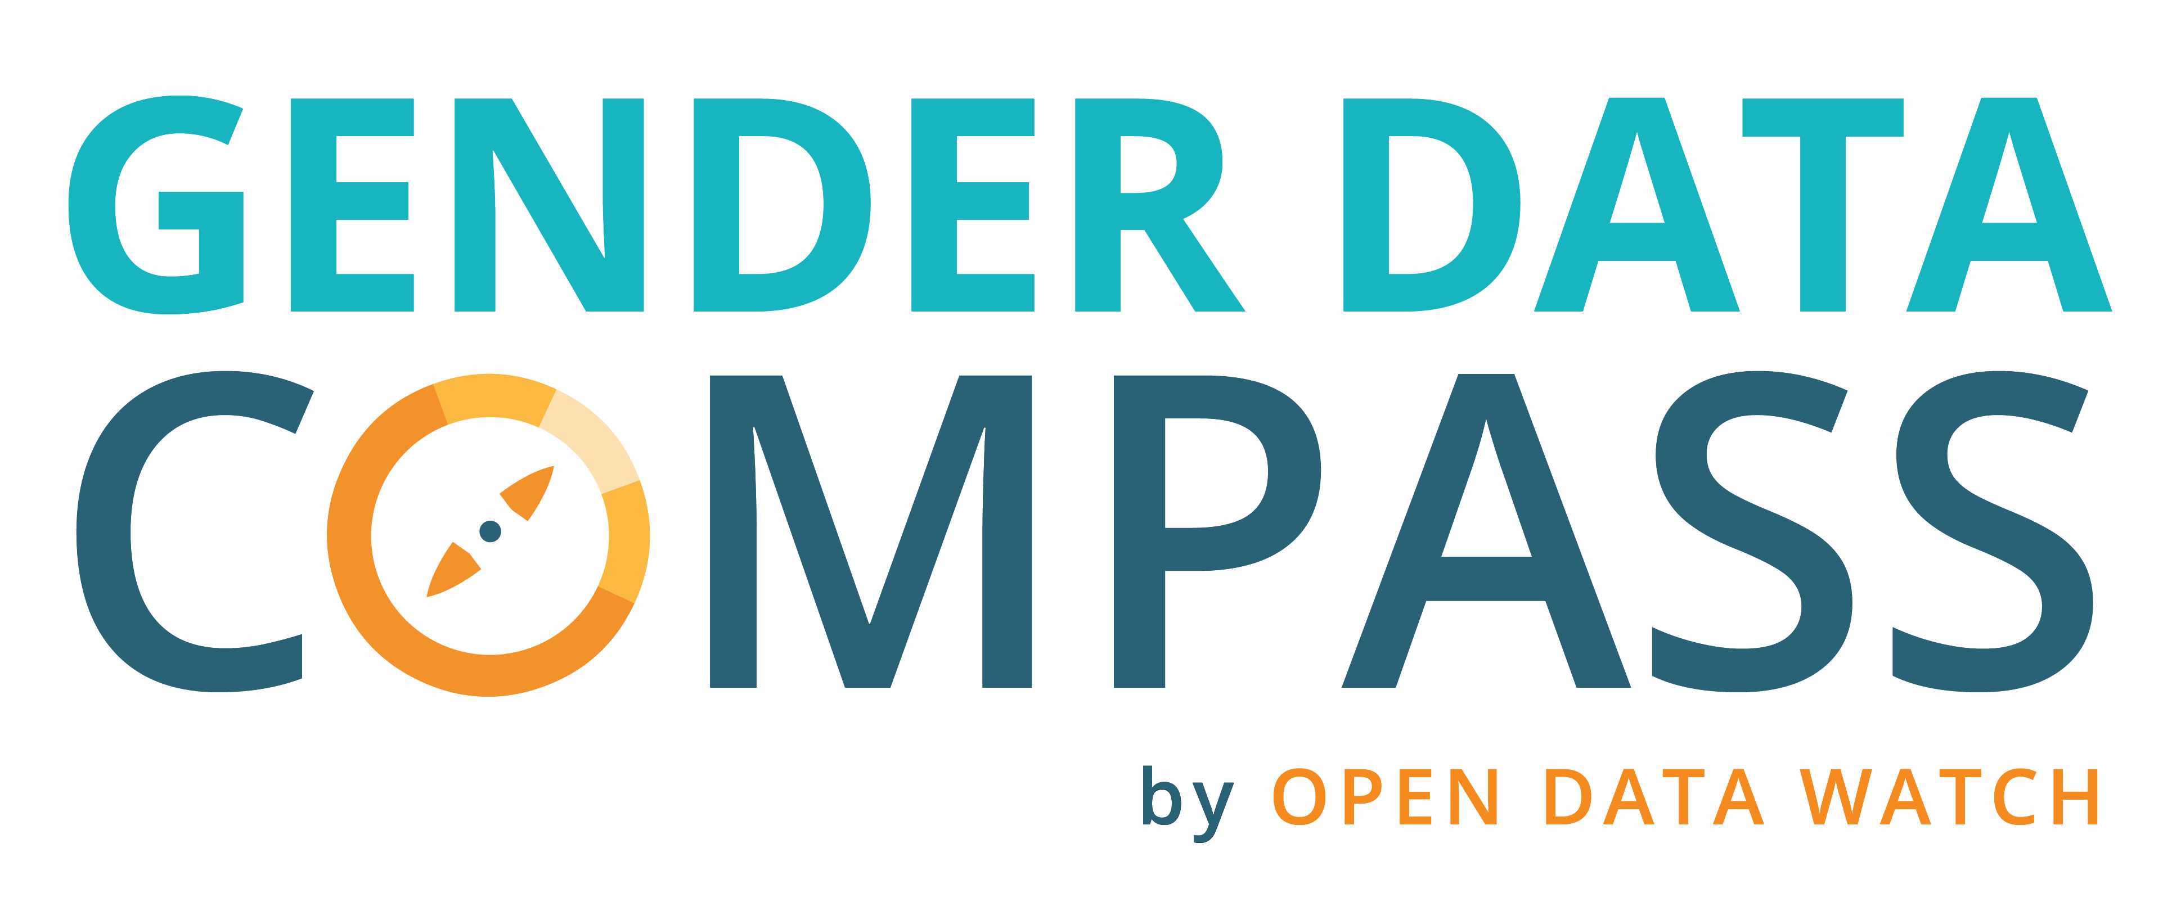
GENDER DATA COMPASS: BY THE NUMBERS
185 countries assessed
53 quantitative indicators
17 qualitative indicators
100,000+ data points
Notes:
The GDC assesses 185 countries around the world, includes 53 quantitative indicators across 10 data categories, and analyzes 17 qualitative indicators of the enabling environment for gender data. This all culminates in over 100,000 data points to help us understand the current state of gender data systems across the world and priority areas for improvement.
OR
The Gender Data Compass (GDC) provides information about national gender data systems and their enabling environment. It documents the current availability and openness of 53 important gender indicators in over 180 countries. It sheds light on critical questions that countries must address to improve their gender data systems: What data are available to understand and tackle issues of gender equality? Are these data accessible and open to all?
The GDC also documents the environment in which the gender data system operates. Does a country have policies and laws to encourage the production and dissemination of official gender data? Is the regulatory framework, funding landscape, and national capacity strong enough to support transformative change? These issues are crucial to understanding the deeper context in which improvements can occur.

Slide 7
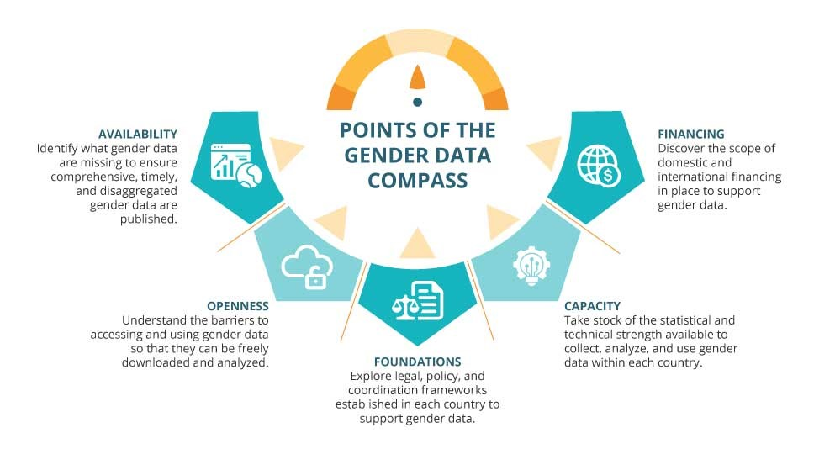
GENDER DATA COMPASS: AT A GLANCE
A New Tool to Understand and Improve Gender Data Systems Globally
Notes:
The GDC has 5 cardinal points to provide a comprehensive overview of gender data systems in a country:
Availability identifies the extent to which gender data are available across 53 gender relevant indicators through NSO websites, ministry websites, or international organizations. To be complete, they must not only be available by sex but across multiple years with geographic and other important disaggregation such as age or disability status.
Openness measures the barriers to accessing and using available gender data. This includes assessing whether data are available in non-proprietary and machine-readable formats, whether an open data license exists, the availability of bulk download options, and the availability of metadata.
Institutional Foundations are the legal, policy, and coordination frameworks that support the collection, publication, and use of gender data.
Capacity reflects a country’s level of technical and statistical capacity to manage and maintain statistical systems that produce gender data. A robust statistical system produces regular population censuses, thematic surveys (such as labor and agriculture), and real-time data through administrative systems.
Financing examines whether national budgets make specific allocations for gender data and the extent of official development assistance (ODA) provided for gender data within countries.
So what does all this information tell us about the global state of gender data?

Slide 8
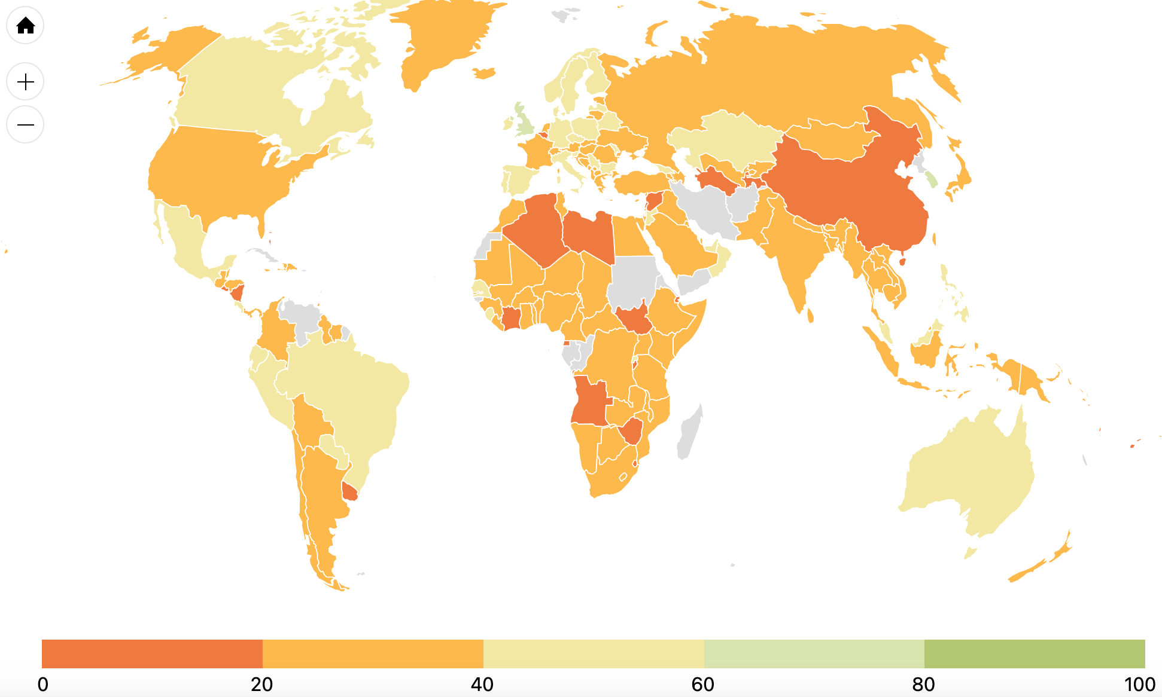
DIRE STATE OF GENDER DATA AVAILABILITY & OPENNESS
Notes:
Unfortunately the news isn’t good -- The state of gender data systems in countries around the world is extremely poor. In most countries, gender data are not readily available, and where they are available, they are often not fully open.
The combination of the availability and openness scores shows the extent to which policymakers and citizens in 185 countries can publicly access and use gender data. GDC results indicate that the situation is dire: the combined score for the world shown on the slide was only 30.7 and more than half the countries fell below the mean. The availability and openness scores, like the other GDC points, are based on publicly available information. Countries making progress behind the scenes are encouraged to make their work public so that others can look to their examples and celebrate progress.
Given what is going on globally, let’s take a deeper look at the situation in the Africa region.

Slide 9
REGIONAL SNAPSHOT: OPPORTUNITIES FOR IMPROVEMENT
Number of countries in Africa by score and gender data compass point
Notes:
Regional scores across the 5 point to key opportunities for improvement.
The Gender Data Compass (GDC) looks at four elements of gender data availability: whether the relevant indicators are available with sex-disaggregation, geographic disaggregations at the subnational level, other non-geographic disaggregations, for multiple years. As the chart on the screen shows, many countries are either not publishing gender-relevant indictors or if they are publishing them, they aren’t sex disaggregated.
However, the situation regarding openness is worse. Making gender data available that can be freely accessed and reused increases their potential impact. Simply uploading a table or graph to a website is not enough. To make data fully open, they should be published in an open format that is both machine-readable, so the data can easily be extracted for reuse, and non-proprietary, so that open-source programs can be used for analysis. As you can see from the chart, even if data are available, they are less likely to be open creating critical barriers to accessing and using gender data for the public good.
The story when it comes to the broader enabling environment supports these technical findings: While most countries in the region have the necessary legal and political mandate and statistical and technical capacity to produce and analyze gender data, most countries do not have the necessary financing to maintain a robust gender data system.
So which sectors have the most to gain from improving availability and openness?

Slide 10
DESPITE AVAILABLE DATA, OPENNESS REMAINS A PRIORITY
Average availability and openness scores in Africa by sector

Slide 11
RECOMMENDATIONS FOR IMPROVEMENT
Data Availability
Prioritize publishing sex-disaggregated data
Collect gender data with disaggregation by multiple characteristics
Implement data instruments at the household level that also collect intra-household information
Data Openness
Publish a uniform open data license on every website and portal where data exist
Adopt an open by default gender data policy
Prioritize publishing data in open formats
Institutional Foundations
Mainstream gender data in statistical plans
Strengthen collaboration between NSO and gender ministries
Promote data integration within gender ministries
Capacity
Improve foundational systems to increase frequency of data production
Explore innovation in gender data collection
Prioritize time-use and labor force surveys
Financing
Allocate dedicated funding for gender data
Mainstream gender data in bilateral and multilateral support
Improve transparency and monitoring of funding for data and gender data
Notes:
Overall, what do the GDC results indicate when it comes to improving gender data systems across the globe:
Prioritize publishing sex-disaggregated data to enable a nuanced understanding of gender dynamics, offering insights into disparities that might be obscured when analyzing aggregate data.
Collect gender data with disaggregation by multiple characteristics: Gender disparities intersect with other aspects of identity, such as age, race, ethnicity, and socioeconomic status. To capture these complexities, data instruments should consistently disaggregate gender data by multiple characteristics of the population. This will shed light on how several factors can intersect to influence gender dynamics.
Implement data instruments at the household level that also collect intra-household information. Such an approach not only recognizes the unique roles and experiences of each individual but also ensures that gender data are as comprehensive and inclusive as possible.
Publish a uniform open data license on every website and portal where data exist. This not only informs users of the data's status but also encourages trust and reliability in the data. Employing a uniform data license across all government websites is recommended to avoid confusion among users.
Adopt an open by default gender data policy. Open by default policies require data to be made publicly available with only a limited number of exemptions (for reasons of security, for example, or privacy protection). These policies can help standardize open data practices and increase the likelihood that open data practices are sustained.
To unlock the full potential of open data, governments should prioritize publishing data in a format that is both machine-readable and non-proprietary.
Mainstream gender data in statistical plans. By placing gender data at the forefront of statistical planning, countries can work towards a more inclusive and gender-sensitive data landscape.
Strengthen collaboration between NSO and gender ministries. This partnership should aim to align data collection, analysis, and dissemination efforts, guaranteeing that gender data are effectively harnessed to support the development and evaluation of gender-specific policies and programs.
Ensure that gender data are actively used in the development and implementation of policies and programs by relevant gender ministries. Gender data should be integrated into their planning documents, offering evidence-based insights for crafting strategies that are more responsive to the unique needs and challenges faced by diverse gender groups.
Improve foundational systems to increase frequency of data production. Better gender data starts with regular, reliable information on who and where people are within a country, information gathered through census and civil registration and vital statistics systems. Producing more sex-disaggregated data through these two mechanisms will have an outsize impact on the availability of gender data.
Embrace innovation to diversify and enhance gender data collection efforts. By incorporating emerging technologies and methodologies, including regarding digitalization, countries can update and enrich their gender data more frequently and comprehensively.
It is crucial to regularly conduct time-use and labor force surveys to collect critical data on employment, unpaid care work, and time allocation. These surveys provide indispensable insights into the dynamics of labor and the distribution of responsibilities within households and communities, contributing to a more comprehensive understanding of gender dynamics and inequalities.
Prioritize the allocation of dedicated funding for gender data within national statistical budgets, including funding from both domestic and international sources. Budget commitments increase the likelihood that gender data collection, analysis, and dissemination will receive the financial backing they need to flourish.
Advocate for the mainstreaming of gender data financing within bilateral and multilateral donors' gender equality agendas. This contributes to gender data’s inclusion in wider development initiatives.
Improve transparency and monitoring of where countries stand around funding for data and gender data

Slide 12
GENDER DATA COMPASS’ POTENTIAL
New Report, Data, Findings, and Country Rankings Out Now https://gdc.opendatawatch.com/
Use the GDC to:
Understand the state of gender data from the user perspective
Benchmark progress to regional peers overtime
Identify priority areas to improve scores
Review recommendations for all five points of the GDC
Request a targeted and customized technical assistance workshop (contact: GDC-input@opendatawatch.com)
Notes:
So to summarize, what can you do with the GDC?
Understand the state of gender data from the user perspective
Benchmark progress to regional peers overtime
Identify priority areas for to improve scores
Review recommendations for all five points of the GDC
Request a targeted and customized technical assistance workshop

Slide 13
PLANNING FOR BETTER GENDER DATA: HIGHLIGHTING THE BRIDGE TOOLKIT
Notes:
Now that we’ve discussed some of the data that are available about the state of gender data systems globally, regionally, and nationally. What can be done with that information to ensure that we improve our data systems? One tool to help countries understand the maturity of their gender data systems and then develop priorities accordingly is the Building Responsive Investments in Data for Gender Equality (BRIDGE). This self-assessment can be used by countries to dig even deeper to illuminate priorities and develop action plans.

Slide 14
GOALS OF THE BRIDGE TOOL
Assess gender data system maturity level in the context of a country
This is not a comparative tool for ranking countries, each assessment stays with the country.
Identify country priorities for gender data financing
Based on these priorities, a country can then engage other parts of government, non-government actors, and external partners.
Assist governments in planning for better gender data financing
Countries to better integrate gender data systems into their gender equality plans and provide support by raising the profile of gender data through advocacy.

Slide 15
ELEMENTS OF A GENDER DATA SYSTEM
Notes:
Governance: Institutional governance structures and the policies, strategies, political support, and statistical laws needed to cultivate and support gender data.
Financing: The budget, sources of financing, and the financial stability and independence of a gender data system.
Technical capacity: The capacity of staff to collect and produce gender data, along with the necessary technological capabilities needed to produce gender data and promote its use.
Data instruments: The tools and processes for collecting data: CRVS, HMIS, EMIS, censuses, surveys collecting information on households and individuals.
Stakeholder coordination: Mechanisms set in place for gender data producers and users to coordinate and
communicate, with the NSO acting as a data steward in the center.

Slide 16
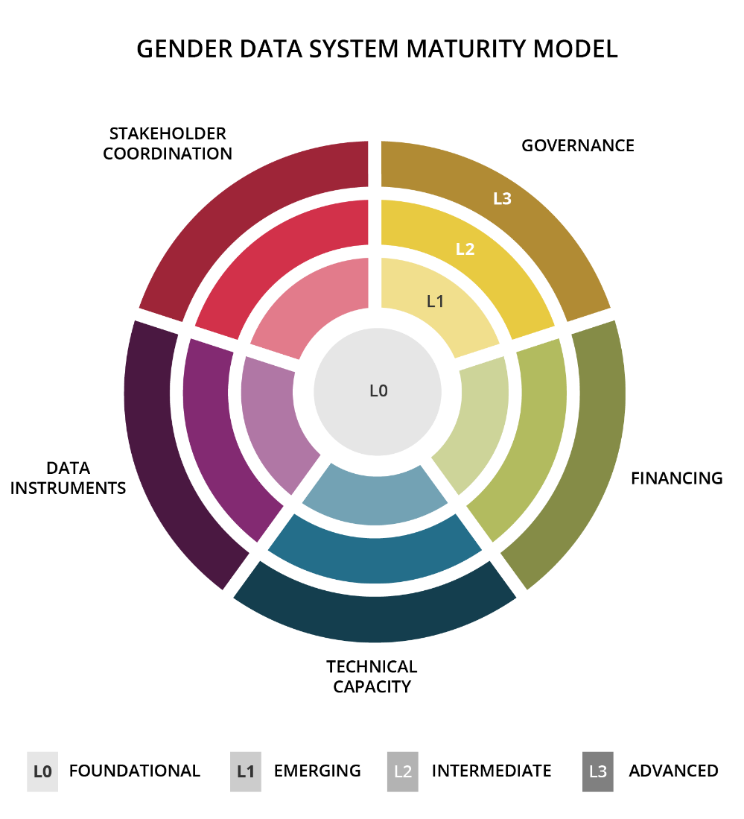
GENDER DATA SYSTEM MATURITY MODEL IN FIVE DIMENSIONS
Each dimension involves four stages of maturity – L0 to L3.
Measurable indicators of gender data outcomes and processes identify the steps needed to move to the next level.

Slide 17
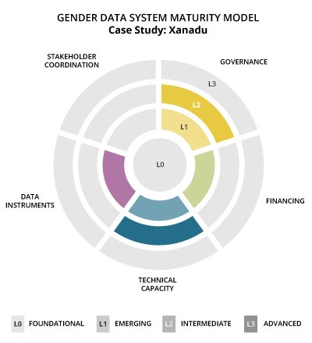
EXAMPLE ASSESSMENT RESULTS

Slide 18
1
Maturity model: Served as a foundation for the tool. The gender data system maturity model assesses the capacity of NSSs to produce a robust set of gender data. The maturity model consists of five dimensions across four levels of maturity.
2
Assessment: Consists of a set of questions across the five dimensions.
THE BRIDGE TOOL:
A SUITE OF PRODUCTS
3
Scoring sheet: Assessments are scored based on the four levels of maturity outlined in the maturity model. Scores are reflected in radar graph.
4
Methodology note describing assessment and scoring criteria.
5
Summary note detailing scoring outcomes. (not public)
6
How-to-Guide for using suite of products

Slide 19
GROUP ACTIVITY

Slide 20
ACTIVITY INSTRUCTIONS
Xanadu is a small, low-income imaginary country in Asia. The National Statistical Office (NSO) is undergoing a strategy refresh and recently reviewed their Gender Data Compass (GDC) country profile to compile a summary of the state of their gender data system to help identify new priorities and opportunities for improvement.
Use the summary sheet to help provide guidance to the Xanadu NSO staff for their next strategy. Questions to consider include:
Based on your experience, what topics or data instruments can the NSO easily prioritize to fill gender data gaps?
Based on your experience, what is one way the NSO can coordinate and collaborate better with data producers and users across the National Statistical System?
How can Xanadu ensure that more gender data are openly available?
Notes:
“Now that we’ve gone through these two tools, we want to put some of this information into practice. On each table you’ll find a summary sheet of our imaginary country, Xanadu’s, GDC country profile. Xanadu is a small, low-income country in Asia. The National Statistical Office (NSO) is undergoing a strategy refresh and recently reviewed their Gender Data Compass (GDC) country profile to compile a summary of the state of their gender data system to help identify new priorities and opportunities for improvement. Please spend a few minutes reviewing the document and use the summary sheet to help provide guidance to the Xanadu NSO staff for their next strategy. Questions to consider as a group include:
Based on your experience, what topics or data instruments can the NSO easily prioritize to fill gender data gaps?
Based on your experience, what is one way the NSO can coordinate and collaborate better with data producers and users across the National Statistical System?
How can Xanadu ensure that more gender data are openly available?
After you work on this at your tables, we’ll come together as a full group to discuss the activity.”

Slide 21
THANK YOU
Data2x.org opendatawatch.com @Data2X @OpenDataWatch

